Slide 1

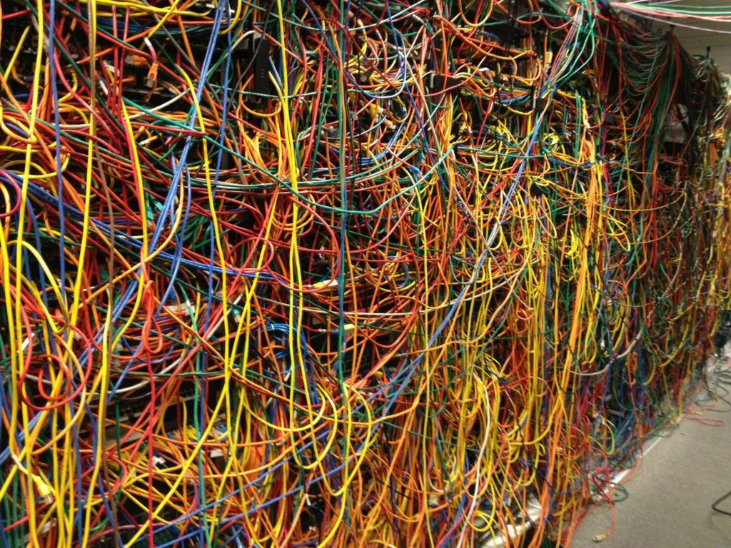
HPC Cluster Intro
Notes:
Hi everyone, my name is Farukh and I’m the lab tech.
For the past half year I’ve been getting acquainted with the FIU High Performance Computing (HPC) cluster and how it could be applied as the primary computing resource for the lab.
When going over a new technology I’ve personally found it useful to view illustrative diagrams to get the overall gist of things before heavily going into its background.
For that reason this presentation will mostly be visuals and me talking. If you are interested in a more in-depth background you can always check out the ndclab wiki which talks about all these technologies but in-depth
This presentation will serve as a succinct outline of lessons and use-cases that you can utilize yourself to accomplish your research and computation goals.
The image to the right is poor cable management and the image to the left is a Jackson Pollock painting.

Slide 2

Content
HPC, NDC, & YOU
Getting Started
Structure
Proper Usage
FAQ
Notes:
These are the following sections that I’ll be going over.
I’ll start out with a brief overview of what the HPC is, how it utilized by our lab.
Next I’ll be going over the preconditions you need to use the cluster.
That will lead into an overview of the architecture of our folder on the HPC
And lastly I’ll be concluding with how to properly use the HPC and some common questions that might arise during your use.
This presentation is interactive, if you have your computer feel free to follow along with the commands. These slides that are interactive will be marked with a small hamster icon.
Always feel free to ask questions during these interactive slides

Slide 3
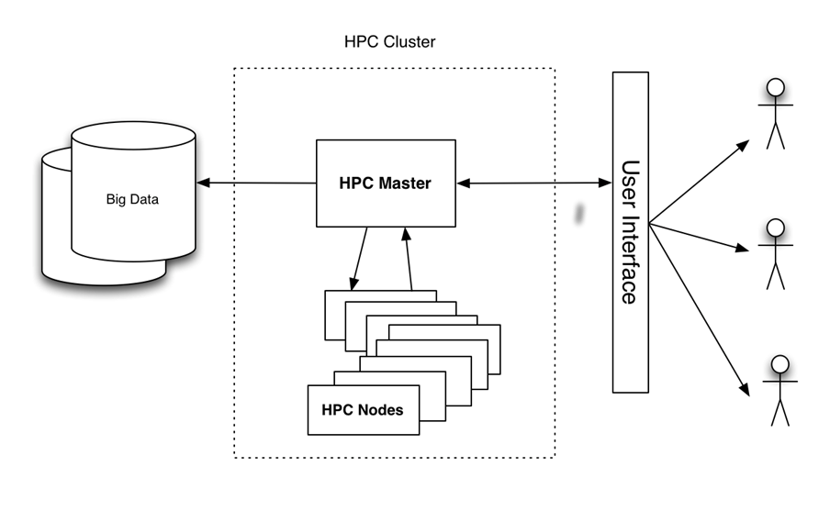

HPC, NDC, & YOU
Notes:
What is the HPC?

Slide 4
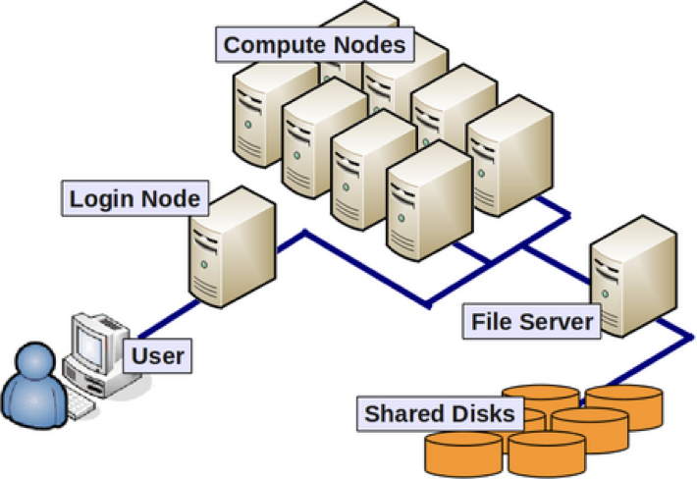
What is the HPC?
A network of computers designed to process computationally expensive tasks and store terabytes of data.
Notes:
Simply put, the HPC is a private, but shared, network of computers that can quickly run programs and warehouse terabytes of data.
To put it in perspective, a good computer with 6 cores could potentially execute 6 programs in parallel.
While he Panther HPC cluster could potentially execute 1500 programs in parallel.
So clearly a great tool but what purpose does it serve us?

Slide 5



How do we use the HPC?
Secure Data Warehouse
High-speed & Parallel Resource
Central Repository of Analyses
Notes:
Well the HPC finds its utility in the NDClab through 3 components:
An IRB compliant data-warehouse
An exponentially faster resource to run software in parallel
A central repository of both private & public analyses
All these facets of the cluster compose a comprehensive overview of each ongoing project within the NDCLab.
I will go over what this all means in the structure section

Slide 6
Getting Started
Notes:
To give you the option of actually interacting with this structure, I will first go over how to log into the HPC

Slide 7
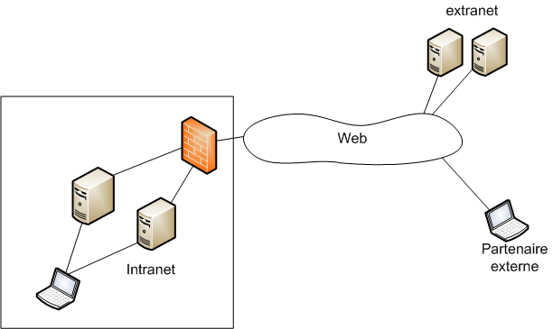

Preconditions
HPC Account
VPN
Antivirus
Notes:
Here are the following preconditions required to log into the HPC, some of these can be resolved immediately while others need to go through an email chain.
They are
HPC account
VPN
Anti-virus

Slide 8

HPC Account
If you are eligible (FIU-affiliated) you can request an HPC account
This can take anywhere from 1-2 weeks
Hard-stop
Notes:
If you do not have an HPC account already that means you will have to peak over with your neighbor if you feel so inclined to interact with the cluster.
If you have proper eligibility you can request an account from Jess which is then sent to IRCC.
In my experience, this can take anywhere from 1-2 weeks depending on how backed up the IRCC is.

Slide 9
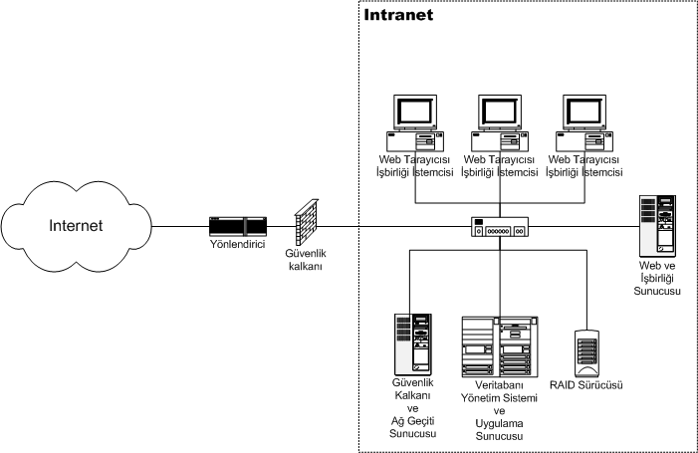
VPN
Only required for off-campus to access the FIU intranet
That is where the HPC cluster lives
To download, visit network.fiu.edu/vpn/
Notes:
However, even if you don’t yet have an account, you could still do the following:
While this is a requirement only when you are not connected to the FIU Secure Wifi it is better to do this sooner than later.
We use a VPN to securely access the FIU intranet where the HPC cluster resides. The intranet is basically a private environment of computers and other services basically cut-off from the rest of the world.
To download the CISCO AnyConnect VPN client, simply visit the link here

Slide 10
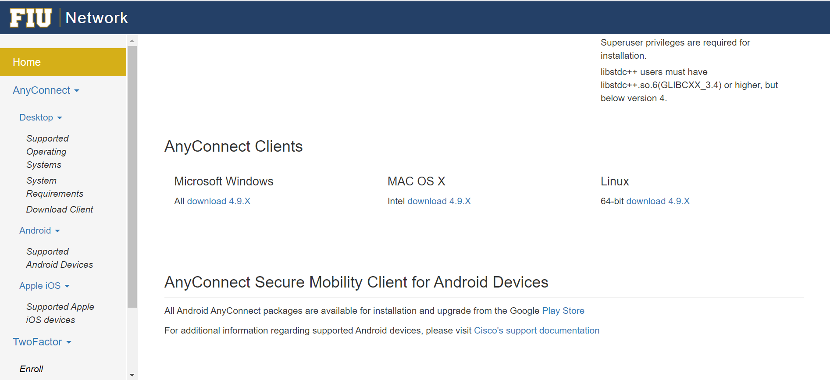
Figure 1. Options to download
Notes:
Once you are on this page, scroll down to the download links and select the link corresponding with the appropriate OS.

Slide 11
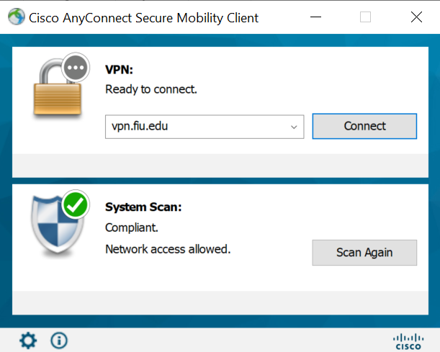
Anti-virus
Highly recommended to install antivirus
For your health!
Free online resource
https://www.avg.com/en-us/avg-antivirus-for-mac#pc
Notes:
Before, attempting a connection, it’s advisable to have a reliable anti-virus installed to your PC.
This does not only guarantee HPC security, but also personal security.
Some computers already have antivirus pre-installed, or you might already have a sufficient antivirus.
If you don’t you could always download free resources:
Avast
AVG
You can verify this after anyconnect installation and verify with the green check-mark on your GUI.

Slide 12
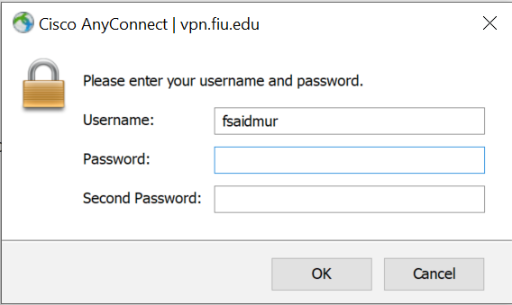
Two-factor authentication
Second password
“sms” for text
“phone” for call
“push” for duo-app message
A message will be sent to your selected medium
More info on network.fiu.edu/vpn/
Notes:
Once you have an antivirus installed, try a test connection by inputting your username and password.
Then there will be an option to input a second password. You have 3 options to use:
Sms to receive a text
Phone to receive a call
Or push to receive a duo app message
The first two options are supposed to be phased out by this week, so “push” is supposed to be the recommended option. However, I find that “sms” still works, albeit slowly.

Slide 13
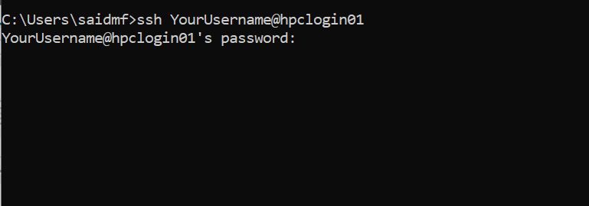
Shell Login Node
Notes:
Once you are connected to the VPN, or you’re using on-campus wifi, you should initially log into the shell through the command prompt or terminal by inputting
ssh your username at hpclogin01
This is the command you use whenever you want to access the terminal of a remote point
You will then be prompted for a password, this will be the same as your FIU password.

Slide 14
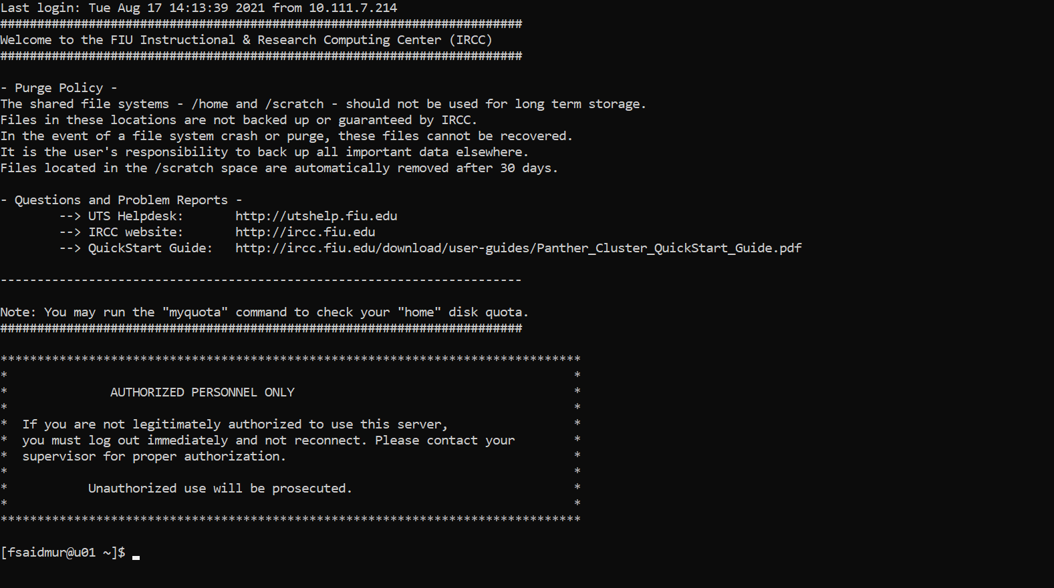
Figure 2. Success!
Notes:
Here is the success screen.

Slide 15
Figure 3. You are here
Notes:
So when you have all this complete, you are in this location of the HPC, the login node.

Slide 16
Navigating the Shell
ls
pwd
whoami
cd <destination>
cd ..
cd /home/data/NDClab
getfacl <destination>
cat <destination/file>
nano <destination/file>
mv <file> <destination>
https://www.geeksforgeeks.org/basic-shell-commands-in-linux/
Notes:
Here are some basic linux commands useful for navigating the shell.
Instead of trying all these commands out, just give one or two a shot to get a feeling of this new mode of navigation. Namely “cd”
Feel free to try “cd /home/data/NDClab” which is where all the relevant files are.
The rest of these commands are useful for listing files, where you are, what you are, reading files, etc.
While visual navigation is more intuitive, the shell is great for fast and specific inquiries, but other than this form is only required for submitting analysis. We will talk more about that in the “proper usage” section.

Slide 17
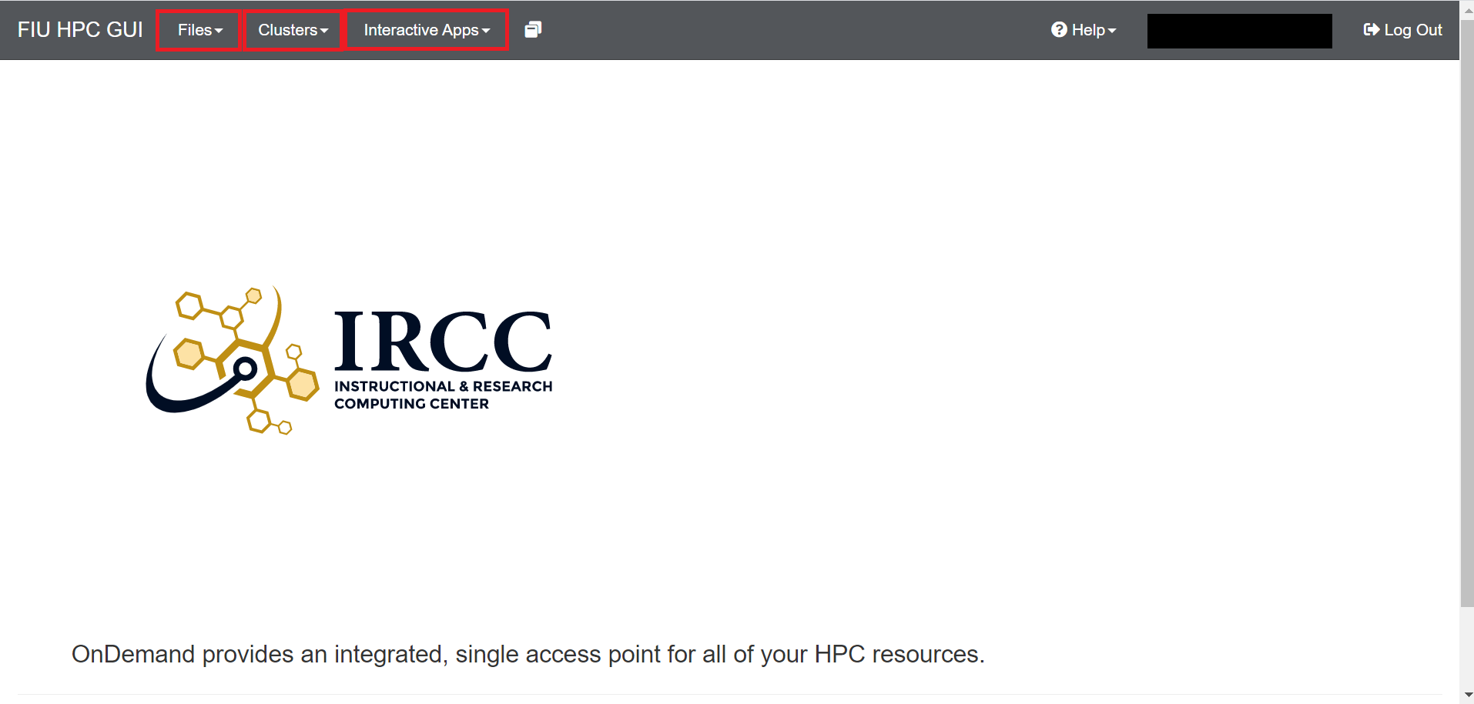
GUI Login Node
Notes:
The other way to access the node is the visual node, which is the login node represented visually
Files: represent a graphical representation of the file structure on the cluster
Clusters: provide shell access to the cluster
Interactive Apps: GUI applications available for HPC account-holders
However, keep in mind that you *must* login to the shell login node first to initialize and access the GUI login node.

Slide 18
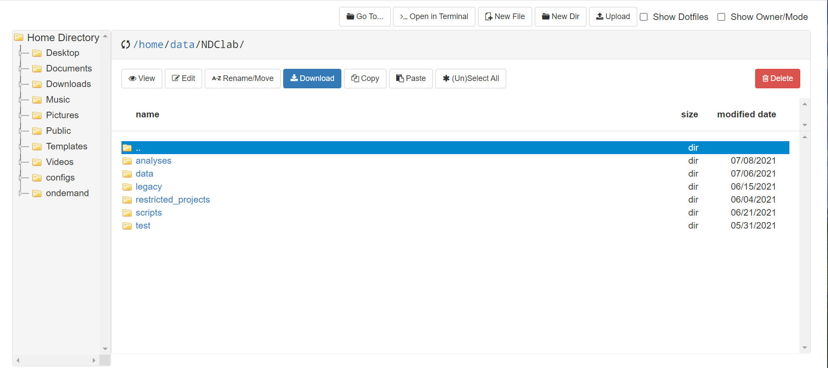
Figure 4. File structure
Notes:
Success screen

Slide 19
Structure
Notes:
Great, so now that we went through this process of hopefully successfully connecting to the HPC, we can now, talk about the structure of the NDC lab folder.

Slide 20


Example Project
data
scripts
analyses
coffee-cog
coffee-cog
coffee-cog
Notes:
Rather than going into too much detail about each section, let’s just go over an example project
Say your research focuses on the effect of caffeine on cognitive control.
So after the research planning side of things are complete, the next part would involve creating 3 directories of the same name. This will be:
A folder under data:
A folder under scripts:
And lastly, a folder under analyses

Slide 21


= locked for non-project view
= anyone can view
Notes:
Here’s a little key here, the locked hamster indicates that the folder is unavailable for view by non-project members, while the wild hamster indicates that anyone can view the folder.

Slide 22
data
coffee-cog
collecting
cleaned
private
public
Notes:
The folder under data is the IRB-compliant data warehouse for both
processed (“cleaned”)
unprocessed (“collecting”) data for a project.
Currently the structure will involve both private and public data existing under the “cleaned” directory

Slide 23
scripts
coffee-cog
coffee-cog
Notes:
Scripts will contain the code that we will eventually use on the hpc in order to run software in parallel and additionally on a faster resource

Slide 24
analyses
coffee-cog
coffee-cog
private
public
Notes:
And lastly, analyses is the central repository that houses both private and public data.

Slide 25
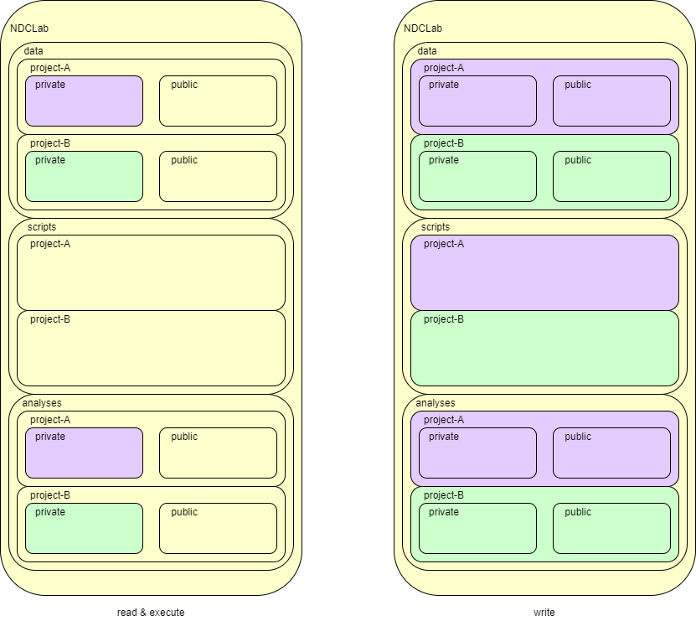
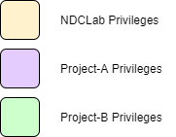
Notes:
Here we have a more in-depth view of how folder structure is realized on the HPC. The left diagram represents read permissions

Slide 26
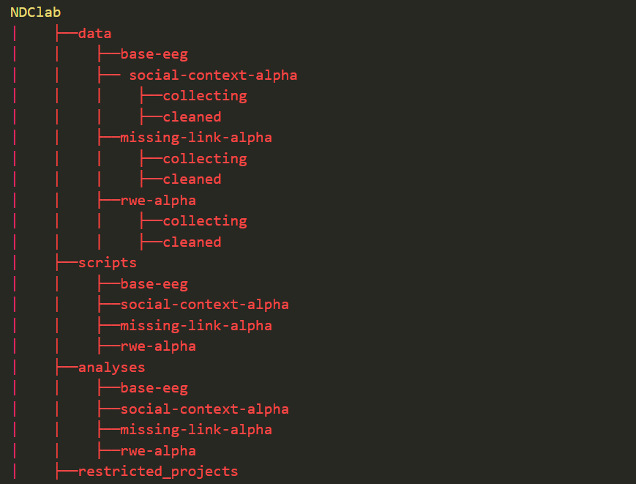
Figure 5. Folder structure view of current projects
Notes:
And here’s a peek of the current folder structure:
Notice how we have 3 folders underneath the main NDC folder: data, scripts, and analyses, and each folder has all the ongoing projects:
Base-eeg, missing-link, social-context, and real world errors.
One thing to note is this architecture will undergo incremental updates based on the needs of the lab, so this representation represents a current iteration and is subject to change.
Any updates will be properly disseminated over slack or whichever medium the lab uses in any future.

Slide 27
Proper Usage
Notes:
And now I’ll briefly go over how we can actually run software on the HPC cluster.

Slide 28
Figure 6. You are here
Notes:
So we’ve been interacting with the login node the entire time but this is *not* the place where you will actually run large programs or analyses.
The IRCC actually advises against running programs just on the login node, as this resource isn’t built for these sort of long-running computations.
In fact, they warn that repeated use of login node for computation could eventually lead to a ban from the cluster.

Slide 29
sbatch slurm
Figure 7. You are still here, but sending jobs there.
Notes:
Instead you must use a job scheduling program called “slurm” which takes in scripts and sends them over to these compute nodes in the background that have been patiently waiting for something to do.

Slide 30
Slurm - Compute Nodes
cd /home/data/NDClab/scripts/coffee-cog
ls
cat hpc_run.sh
sbatch hpc_run.sh
Notes:
To see how we can use slurm, lets also go over a real-world example.
So with those who have computers go ahead and navigate to this folder path. List the files that are present and you should see something called “run.py”.
Now to run run.py we are going to try to run the “hpc_run.sh” script, we can view the contents by using the cat command
So after taking a brief look at these contents we will then submit the job to be handled by the compute nodes by executing “sbatch hpc_run.sh”

Slide 31

Figure 7
Notes:
So if you take a look at the output file produced by doing “cat”, you will actually see that it gives an error message.
The reason for this is that running programs often involves bringing over a set of packages, libraries, and other things.

Slide 32


Containerized Computing
Tool to support reproducibility, ease-of-use, consistency, and generally of a less headache
Introduction to Singularity: Containers for Scientific and High-Performance Computing
Notes:
This is where containerized computing actually comes into play.
This topic requires a whole separate presentation, but I can condense the utility of these technologies into one analogy

Slide 33

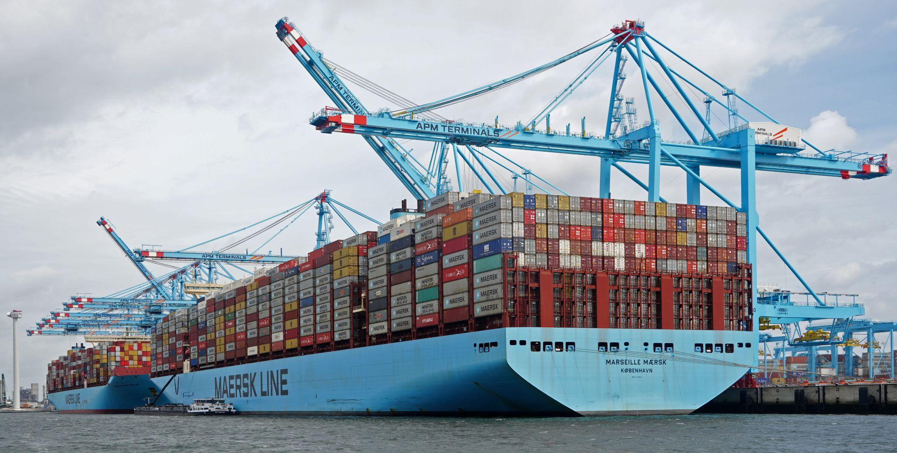
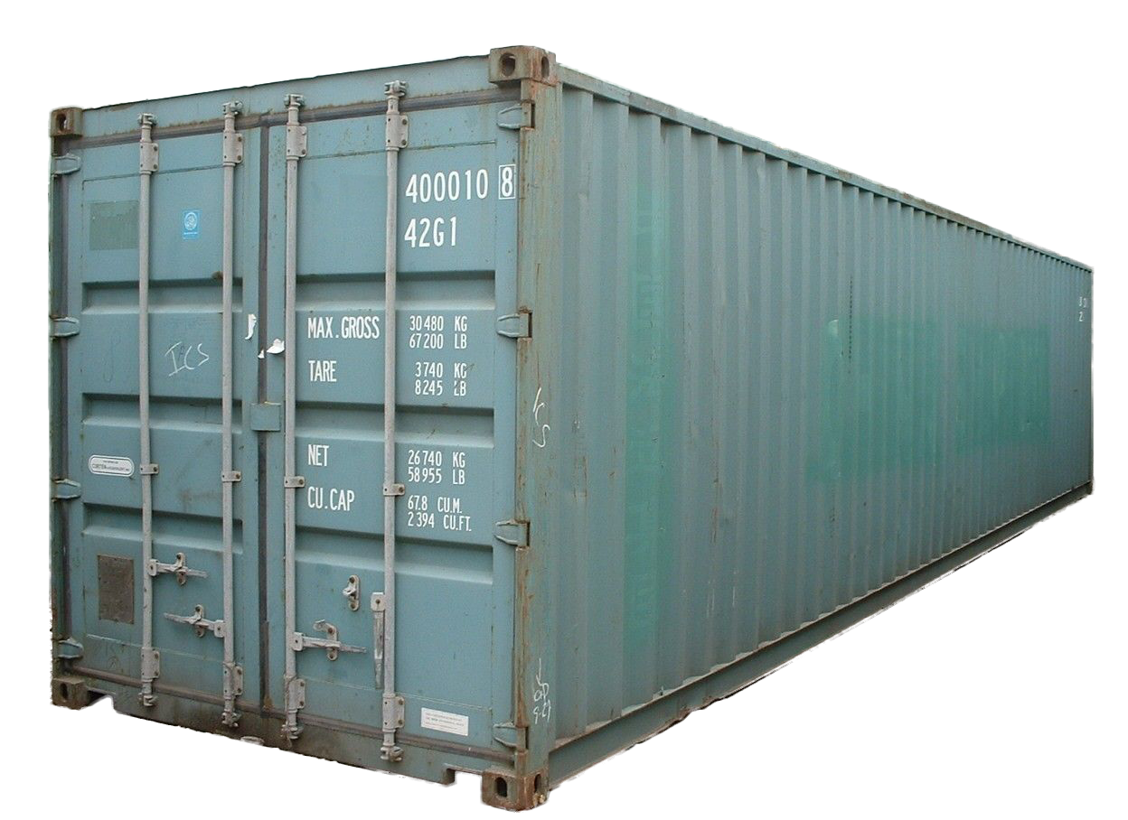
1 month loading
1 month sailing
2 months unloading
0.25 month loading
1 month sailing
0.25 month unloading
Figure 8.
Notes:
So theres this great lecture on singularity that I borrow from, but basically picture this:
Before physical shipping containers existed probably in the early 1900s, loading and unloading a ship took just as long as sailing if not longer.
You would have to individually pack items in the cargo which involves a whole load of cognitive complexity apart from knowing how to sail a ship.
After shipping containers were invented however, shipping became a standardized process where goods were packed into containers themselves and then simply loaded onto the ship.

Slide 34


1 week packaging
5 weeks developing
~no repackaging
10 minutes packaging
5 weeks developing
30 minutes repackaging
Figure 9.
Notes:
Same exact concept with software. Now instead of individually finding pieces of packages that you need to install to run software, you can instead have a container that allows you to quickly set up the program and run it.
I got this 1 week time estimation from previous experiences. One time while doing a survey of algorithms I was pulling repositories that did not come with available images, so what I ended up doing is iteratively running the program and manually recording where it fails.

Slide 35
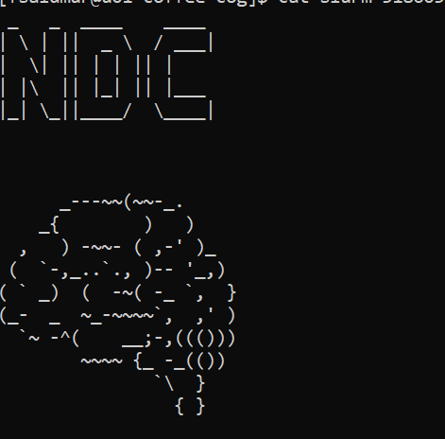
Figure 10. sbatch singul_hpc_run.py
Notes:
So if you take a look at the output file produced by doing “cat”, you will actually see that it gives an error message.
The reason for this is that running programs often involves bringing over a set of packages, libraries, and other things.

Slide 36
FAQ
Can I run any programs on the login node?
Yes small programs are acceptable.
What if I need help doing something on the HPC?
ndclab.github.io/wiki
Lab Tech (Farukh)
IRCC
How do I contact IRCC?
ircc@fiu.edu
...

